Slide 1
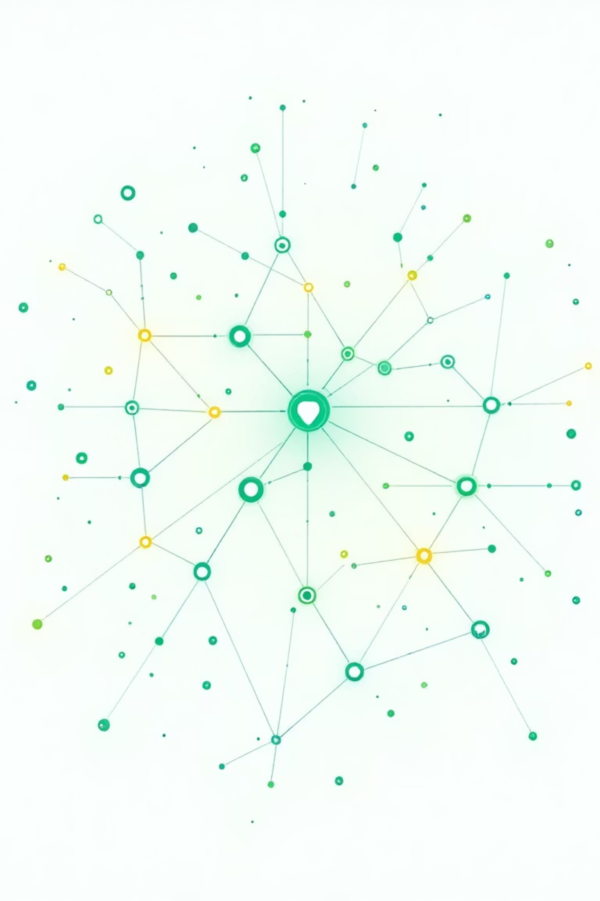

Optimizing Test Case Prioritization With Meta Deep Reinforcement Learning
A breakthrough framework for continuous integration environments using adaptive meta-learning techniques
Published: IEEE Access, October 2025 | King Saud University, Saudi Arabia
Software Engineering IA-II
Shreya Menon - 16010123324
Shreyans Tatiya - 16010123325
Siddhant Raut - 16010123331

Slide 2
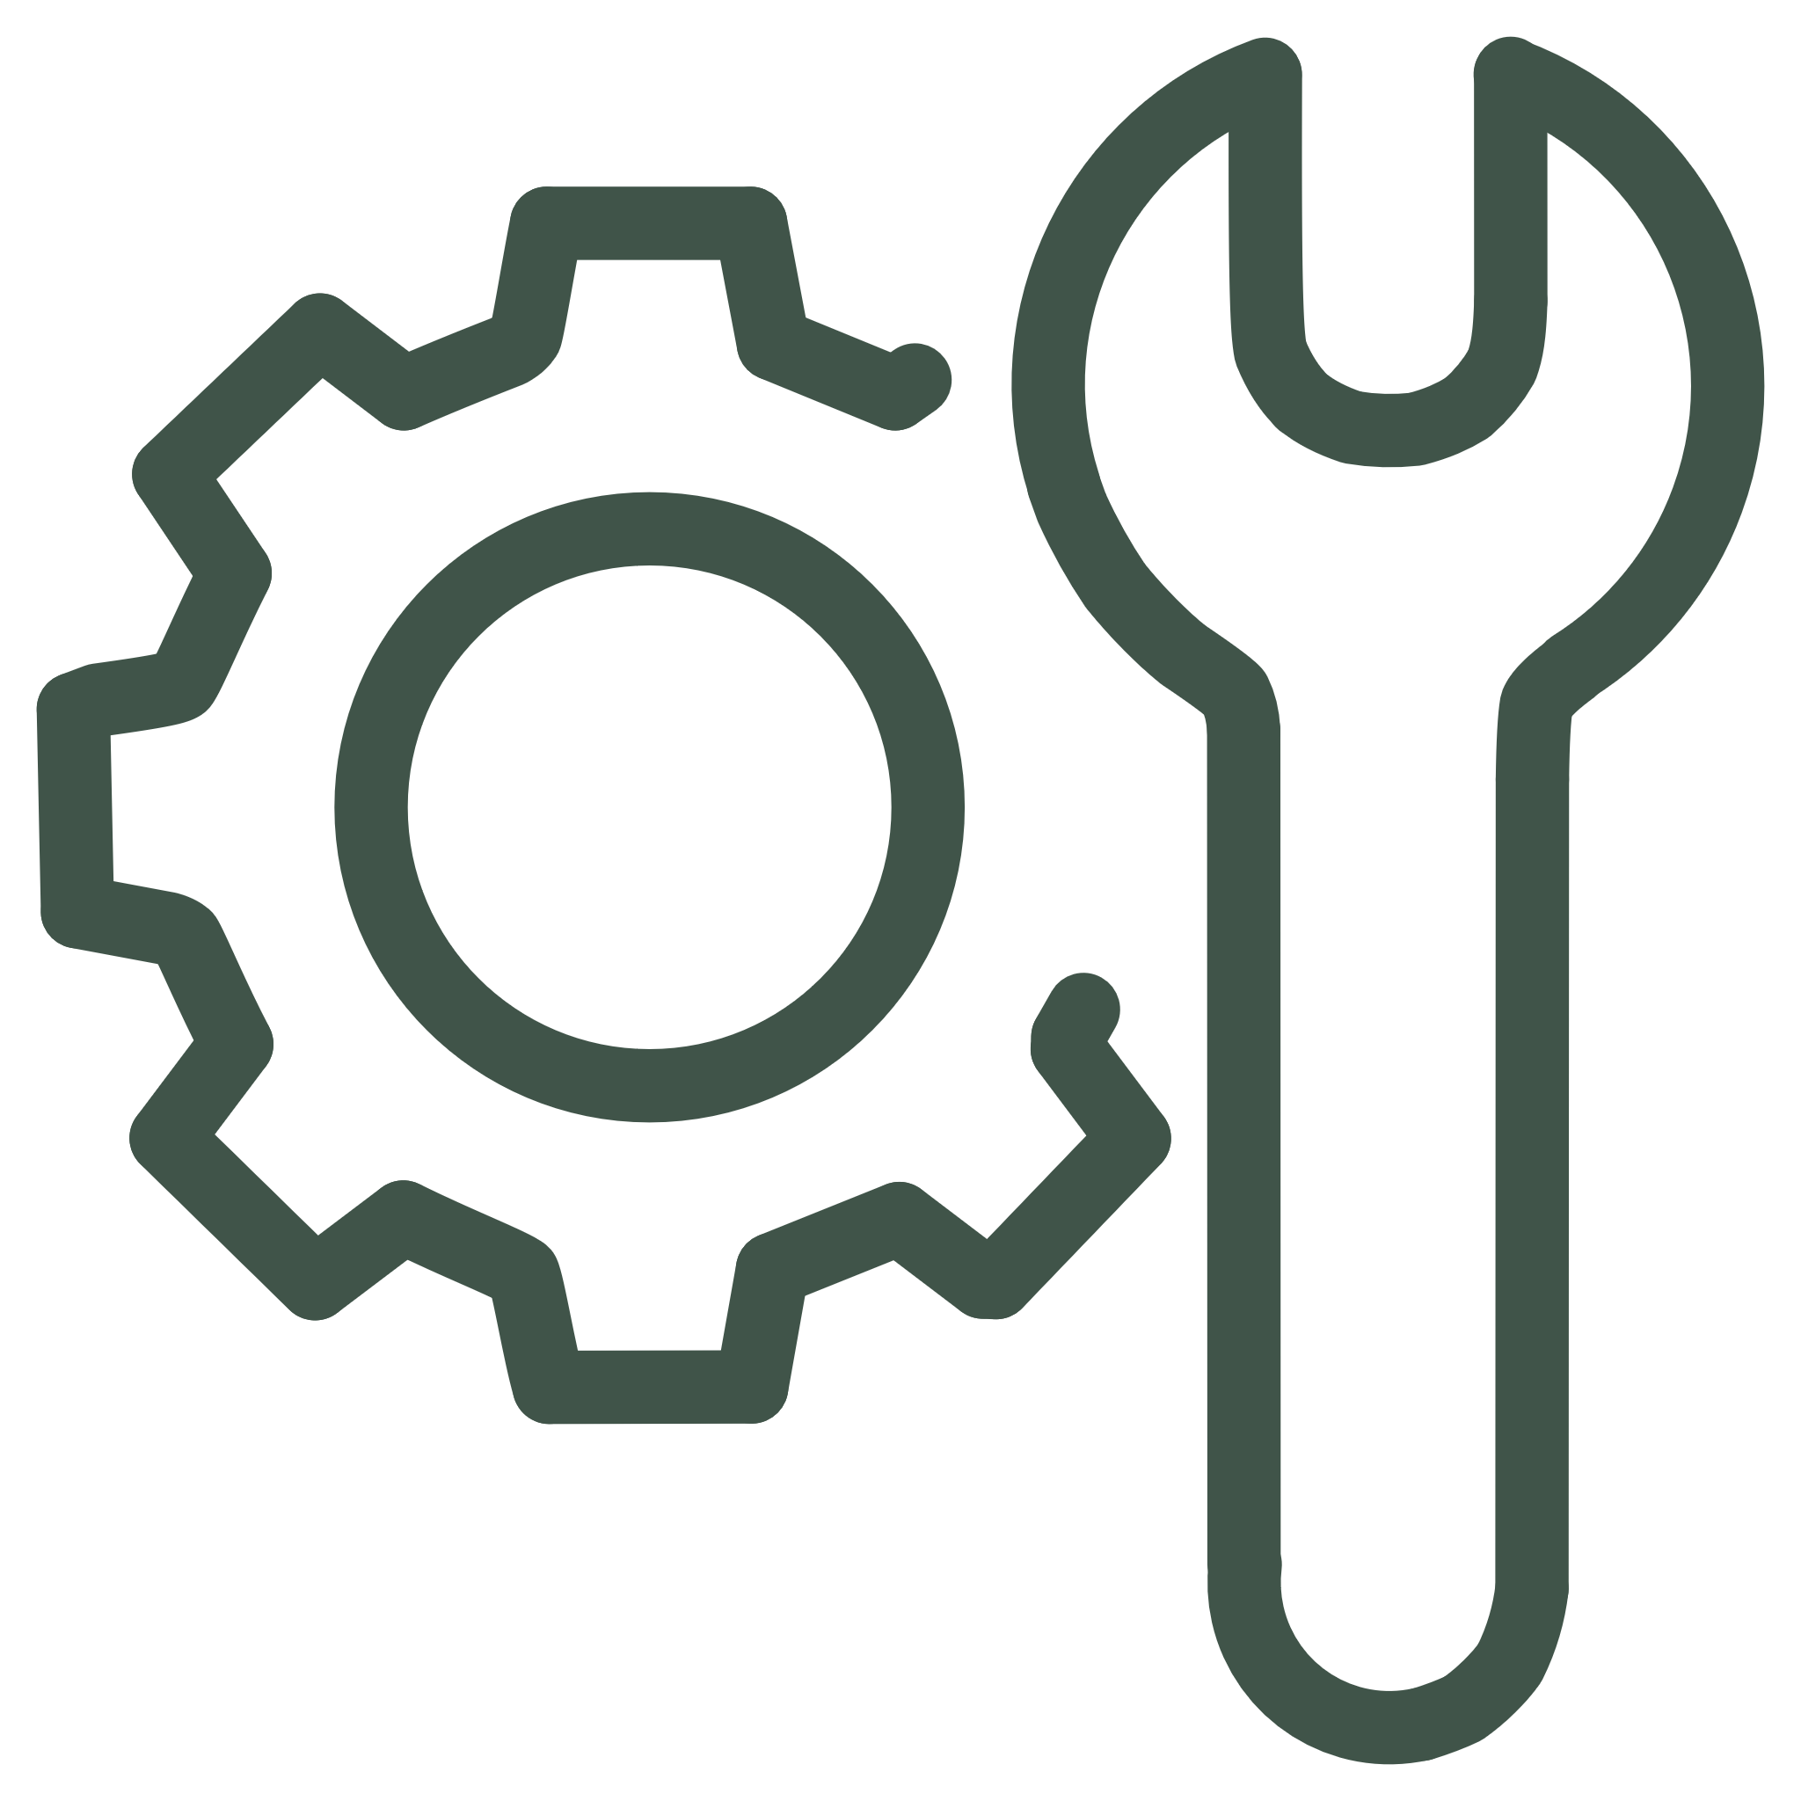


Why Test Case Prioritization Matters
Faster Feedback Cycles
Resource Efficiency
Accelerate CI/CD pipelines, delivering quicker results and enabling rapid iteration on development changes.
Optimize testing cycles, saving computational resources and reducing infrastructure costs associated with extensive testing.
Improved Software Quality
Early Bug Detection
Enhance software reliability by focusing testing efforts on critical areas and high-risk components, minimizing defects.
Identify critical issues sooner in the development process, significantly lowering the cost and effort of bug remediation.

Slide 3
Current Approaches to Test Optimization
Existing Solutions & Limitations
Here's a comparison of common strategies for test optimization:
Test Case Selection
Select only relevant tests, Faster execution
May miss bugs
Suite Minimization
Remove duplicate tests, Reduces test count
Eliminates valid tests
Test Prioritization
Reorder tests intelligently, Keeps all tests + fast feedback
Complex to optimize
Why TCP is Chosen:
Current TCP Limitations:
Maintains complete test coverage
Static, fixed configurations
Finds critical bugs first
Requires manual hyperparameter tuning by experts
Provides rapid developer feedback
Doesn't adapt across different projects
Balances speed and reliability
High computational overhead

Slide 4
The Challenge in Continuous Integration
The Problem
Current Limitations
As software systems grow more complex, test suites become increasingly large and expensive. Regression testing—running all test cases after updates—becomes resource-intensive and time-consuming.
Static configurations lack adaptability
Manual parameter tuning is time-consuming
Existing approaches require extensive training episodes (up to 200)
In 2017, 606 software flaws resulted in $1.7 trillion in economic losses, impacting 3.7 billion individuals worldwide.
High computational overhead

Slide 5



Three Strategies for Better Testing
Test Case Selection (TCS)
Test Suite Minimization (TSM)
Test Case Prioritization (TCP)
Selects specific test cases that align with corrected sections in the system under test.
Reduces size and duplication within test suites by removing redundant test cases.
Arranges test cases to detect faults early and provide rapid feedback—retaining all test cases in execution.
TCP offers a distinct advantage: it maintains all test cases while optimizing execution order for early fault detection.

Slide 6
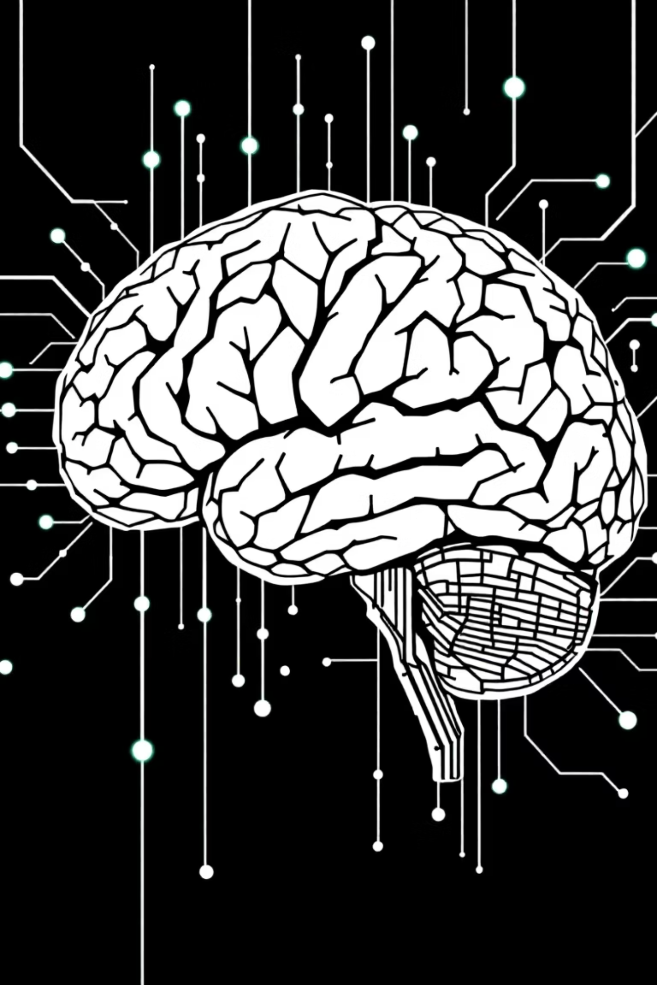

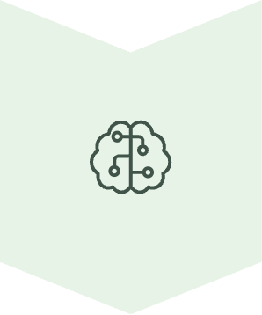

Proposed Solution: Meta-DRL Framework
Pairwise Ranking Model
Compares test case pairs for efficient binary classification
DRL Algorithms
A2C, DQN, PPO, and TRPO for adaptive learning
Meta-Learning
Dynamic hyperparameter adjustment in real-time

Slide 7
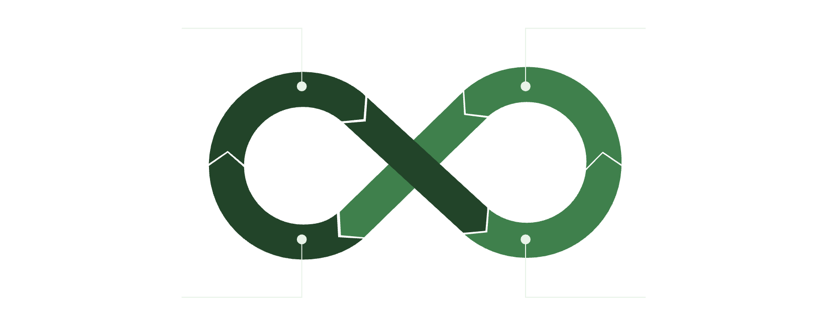
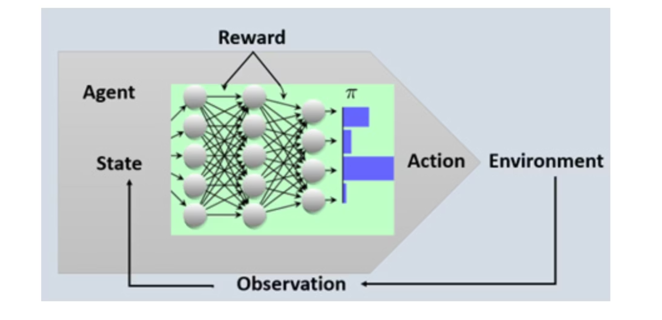
What is Deep Reinforcement Learning?
Deep Reinforcement Learning (DRL) is a powerful AI paradigm that combines the decision-making capabilities of Reinforcement Learning with the perceptual abilities of Deep Learning.
Agent Selects Action
Environment Returns State
Train Deep Network
Agent Receives Reward
This synergy allows AI agents to learn optimal behaviors directly from raw sensory input and experience, enabling them to tackle complex problems in dynamic environments.

Slide 8
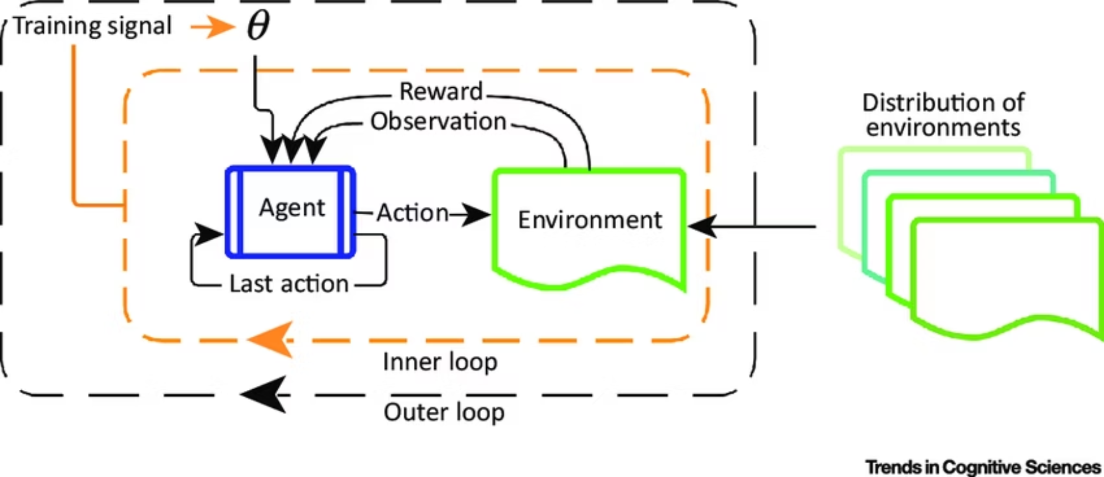

How Meta-DRL Works
Two-Loop Architecture
Inner Loop: Task-specific learning using DRL algorithms to prioritize test cases
Outer Loop: Meta-optimization that learns how to adapt by adjusting hyperparameters based on performance feedback
The system "learns how to learn" by dynamically modifying learning rate, discount factor, cycle count, and episodes.

Slide 9
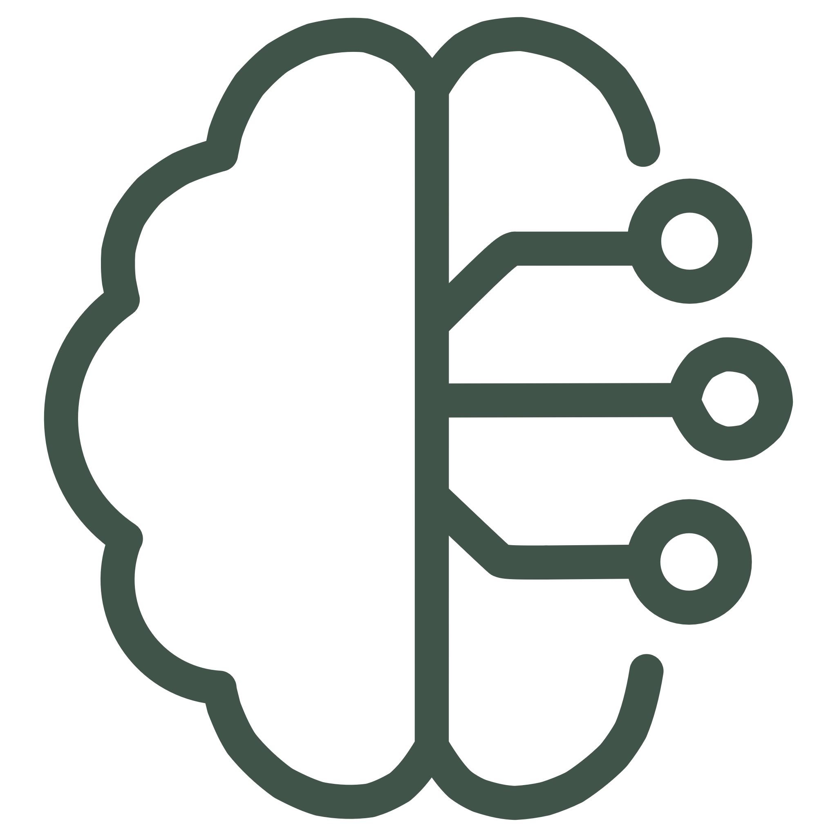
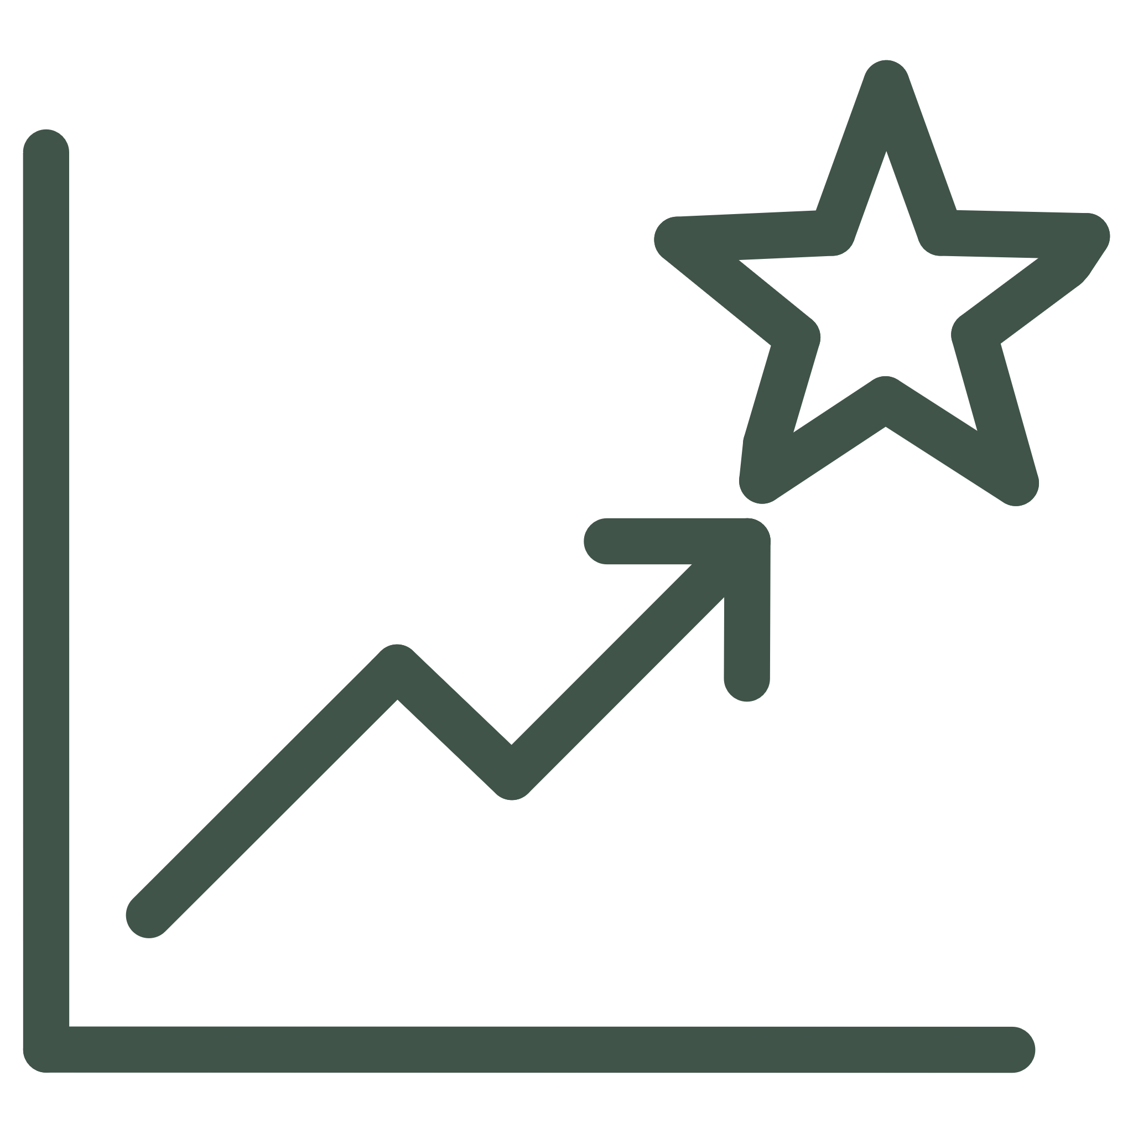
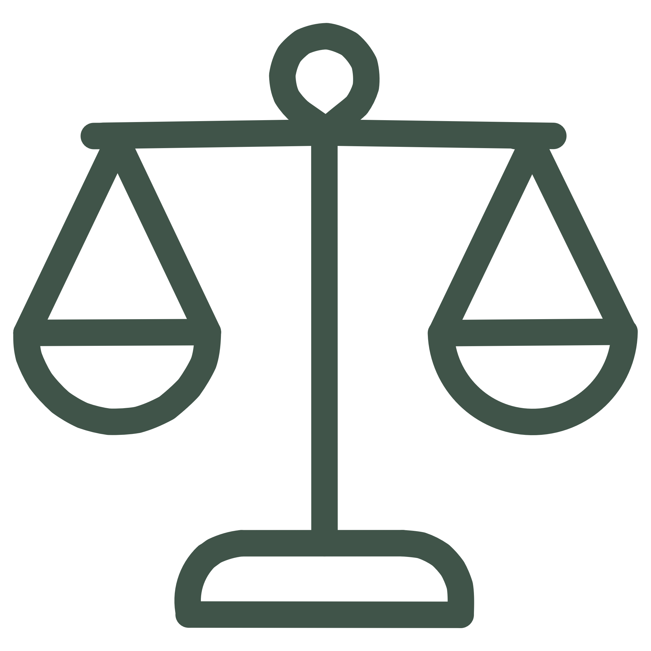

Algorithms Evaluated in This Research
Four DRL Algorithms Explained
A2C (Advantage Actor-Critic)
DQN (Deep Q-Networks)
Type: Policy gradient with synchronous updates
Type: Value-based using neural networks
Mechanism: Combines policy optimization with value estimation
Mechanism: Learns value of each action choice
Advantage: Stable, works well with complex data
Advantage: Fast inference, memory efficient
Best For: Enriched datasets with code metrics
Best For: Real-time predictions
Performance: High accuracy on complex projects
Performance: Rapid prediction times (0.06-1.1s)
PPO (Proximal Policy Optimization)
TRPO (Trust Region Policy Optimization)
Type: Policy gradient with controlled updates
Type: Policy gradient with strict constraints
Mechanism: Prevents large policy changes
Mechanism: Ensures stable improvement within trust region
Advantage: Balances performance and speed
Advantage: Highest accuracy on simple data
Best For: General-purpose deployment
Best For: High-precision fault detection
Performance: Very fast training
Performance: APFD 0.56 on industrial robots

Slide 10







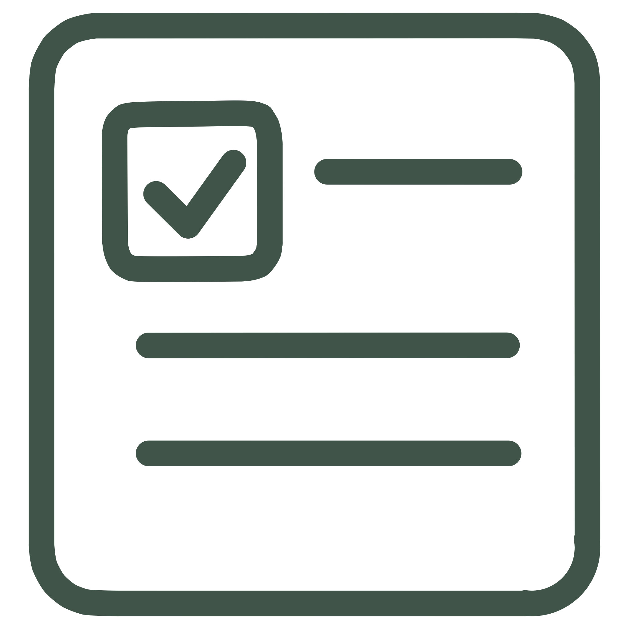
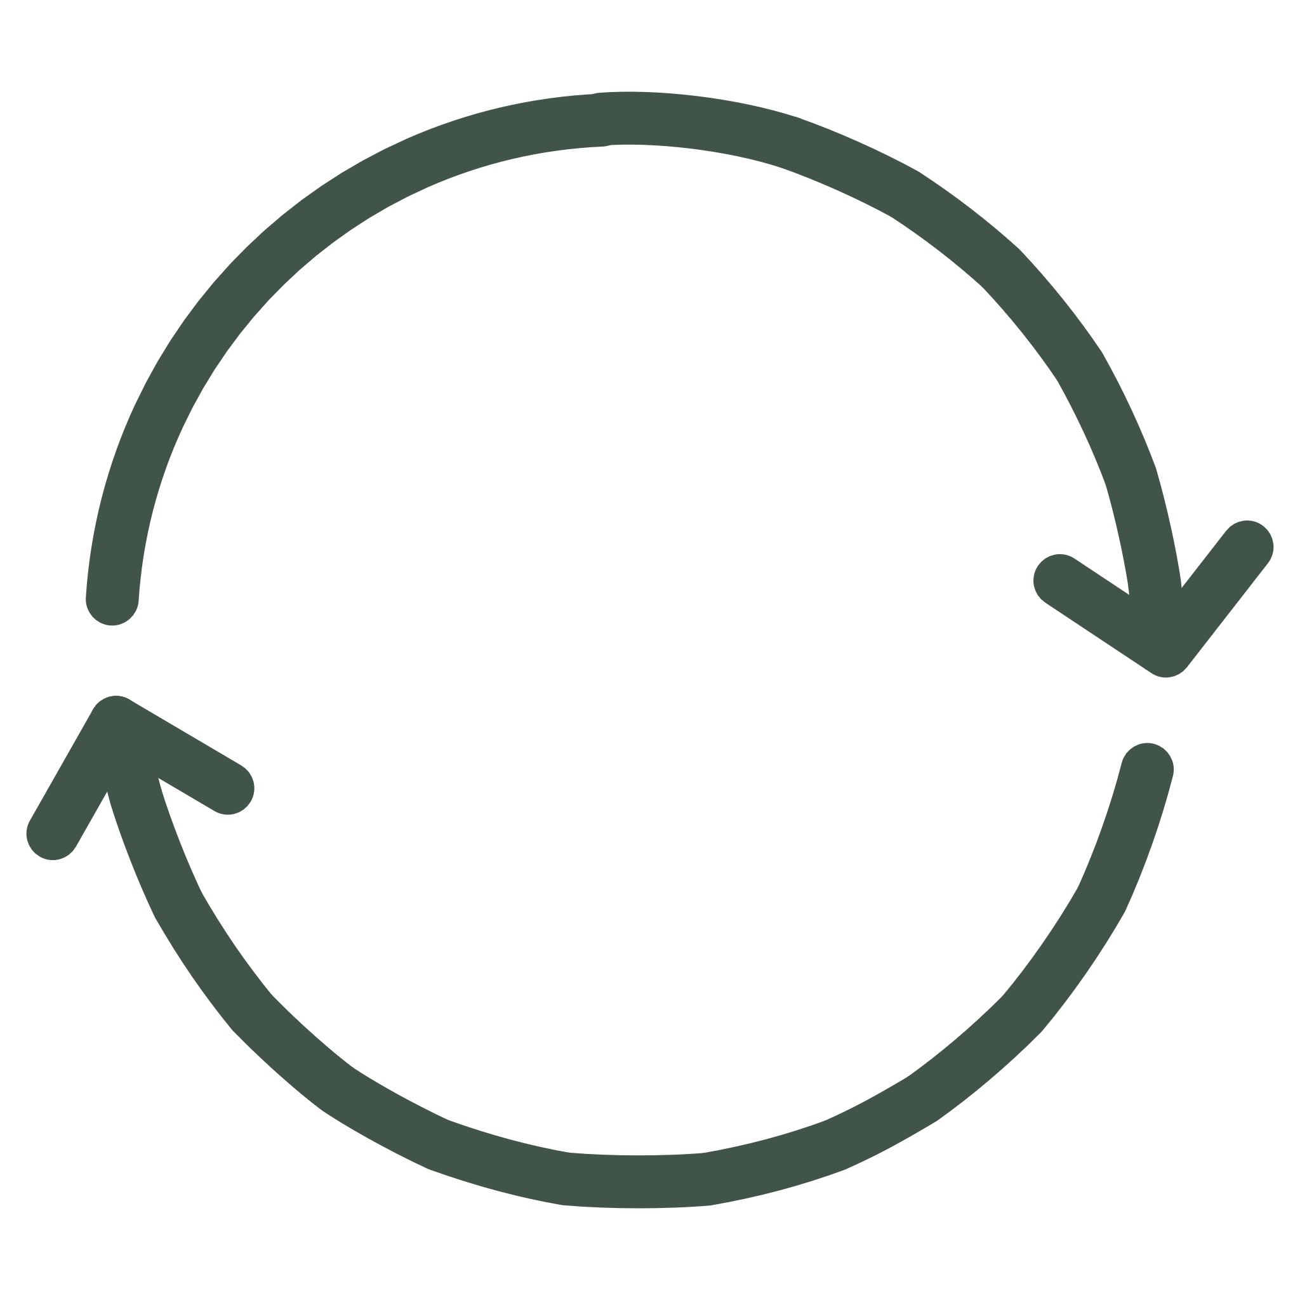
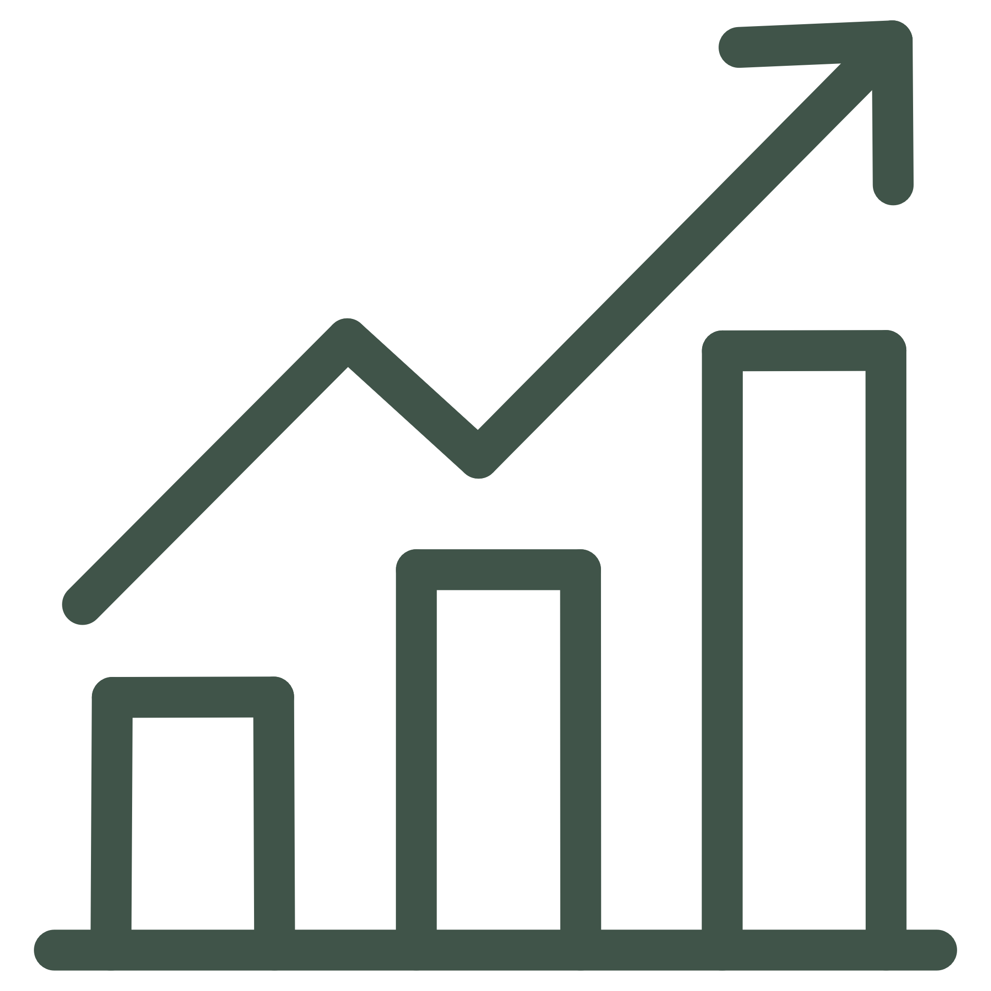


Flow of the Learning Methodology
The Meta-DRL framework employs a dynamic, two-loop learning process to continuously refine test case prioritization, adapting to changing software environments and evolving test suites.
Initialize Framework
Prioritize Test Suite
DRL agent and meta-learning parameters are set up for the current task.
The DRL agent generates an optimal sequence for test case execution.
Refine Strategy
Execute & Evaluate
The adapted parameters inform the next iteration, improving prioritization efficiency.
The prioritized suite is run, and performance (e.g., fault detection) is measured.
Adapt Hyperparameters
Update DRL Policy
The outer loop meta-learner adjusts DRL's learning rates and other settings.
The inner loop refines the agent's strategy based on received rewards.
This cyclical process ensures continuous adaptation, allowing the system to "learn to learn" and maintain high prioritization effectiveness across diverse and evolving CI environments.
Notes:
Slide 10: Flow of the Learning Methodology “Now that we understand how the algorithms think, let’s look at how the overall learning process works inside our Meta-DRL framework. It follows a continuous loop — where the system keeps testing, learning, and improving over time. Step 1 — Initialize Framework:The process begins by setting up the agent, environment, and all learning parameters. Step 2 — Prioritize Test Suite:The DRL agent then examines all available test cases and predicts the best order to execute them, aiming to detect faults as early as possible. Step 3 — Execute and Evaluate:The prioritized test suite is executed, and the system observes the outcomes. Based on performance, the agent receives rewards or penalties. Step 4 — Update DRL Policy:Using this feedback, the agent updates its strategy — reinforcing what worked and adjusting what didn’t. Step 5 — Adapt Hyperparameters:Here the meta-learner steps in. It fine-tunes hyperparameters like learning rate and number of iterations automatically, ensuring the system keeps improving without manual tuning. Step 6 — Refine Strategy:Finally, the updated parameters and experience feed into the next cycle. This loop continues indefinitely, making the system adaptive and self-improving.”

Slide 11
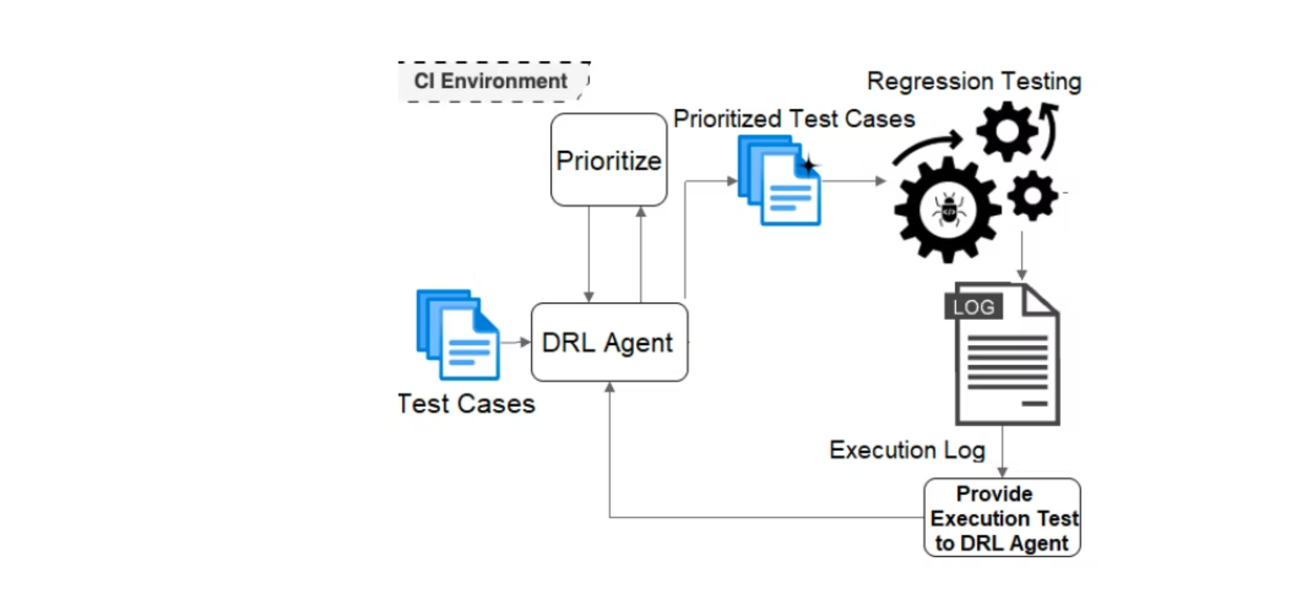
The integration of a DRL agent within the CI environment
Notes:
“Our Meta-DRL framework integrates directly into a Continuous Integration, or CI, pipeline. Think of it like this — whenever new code is pushed, the CI system triggers our Meta-DRL module.It inspects the test suite and related code metrics, then generates an optimized test order. Those tests are executed, results are collected, and two things happen:the development team gets faster feedback, and the Meta-DRL system learns from those outcomes. The meta-learner then adjusts learning parameters based on performance, ensuring the system becomes smarter and more efficient over time.”

Slide 12
Research Methodology & Datasets
Rigorous Experimental Design
This methodology involved extensive experimentation across diverse software projects to validate the Meta-DRL framework's effectiveness. They meticulously simulated continuous integration environments to observe the adaptive behavior of DRL agents under varying conditions.
Performance was rigorously evaluated using industry-standard metrics for test case prioritization, ensuring a comprehensive assessment of the solution's capabilities.
Diverse & Representative Datasets
It leveraged publicly available software engineering datasets, including historical data from large-scale open-source projects. This provided a wide range of test suite characteristics, encompassing varying sizes, fault densities, and execution patterns.
This diverse data selection was crucial for demonstrating the robustness, adaptability, and generalizability of our Meta-DRL approach across different software development contexts.
Notes:
“To validate the framework, the researchers tested it on multiple real-world open-source projects — each with different sizes, complexities, and fault densities. They measured performance using standard evaluation metrics like APFD, or Average Percentage of Faults Detected. This ensured that the results were both scientifically sound and practically relevant across diverse environments.”

Slide 13
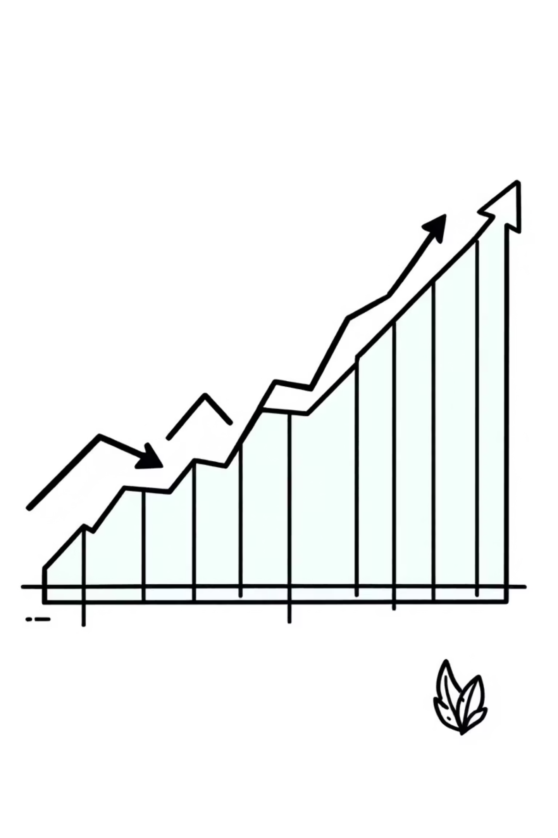
Breakthrough Results
60%
90%
50
Training Time Reduction
Maximum Efficiency Gain
Episodes Required
Compared to existing approaches requiring 200 episodes
In optimal configurations across different datasets
Versus 200 in baseline approaches
8
Datasets Tested
Both simple and enriched CI environments
Notes:
“The results were impressive. Training time reduced by 60% compared to existing models. Efficiency improved by up to 90% in optimal settings. Training required only 50 episodes, instead of 200. And the framework was successfully tested across 8 datasets, covering both simple and complex CI systems. In short — it’s faster, more efficient, and significantly more adaptive than prior approaches.”

Slide 14
Key Innovations
01
02
03
Optimal Cycle Count Strategy
Adaptive Training Framework
Comprehensive Algorithm Analysis
Systematic evaluation of cycle counts to maximize performance while minimizing training episodes—establishing optimal values for each algorithm-dataset combination.
First application of meta-DRL to test case prioritization—dynamically optimizes learning rate, discount factor, cycle count, and episodes based on real-time feedback.
Thorough evaluation of A2C, DQN, PPO, and TRPO across diverse datasets, providing insights into algorithm strengths and adaptability in CI contexts.
Notes:
“This research brought in three key innovations: First, an Optimal Cycle Count Strategy — achieving the right balance between training time and performance. Second, an Adaptive Training Framework — the first application of meta-DRL for test case prioritization. And third, a Comprehensive Algorithm Analysis — comparing four DRL algorithms to identify which performs best in different contexts.”

Slide 15
Impact and Future Directions
Transformative Benefits
Next Steps
Scalability: Works across diverse CI environments without manual tuning
Develop context-aware reward functions
Incorporate real-time CI data streams
Efficiency: Reduces energy consumption in large-scale industrial settings
Expand evaluation beyond APFD and NRPA
Test on more complex real-world datasets
Adaptability: Eliminates trial-and-error parameter tuning
Reliability: Maintains high prioritization accuracy with minimal overhead
Notes:
“Finally, let’s talk about the impact and what’s next. In terms of impact, this framework is highly scalable, energy-efficient, and eliminates manual tuning — all while maintaining reliability. Looking ahead, future work aims to: Introduce context-aware reward functions, Incorporate real-time CI data, Broaden the range of testing metrics, And scale the framework to handle larger, more complex systems. Overall, Meta-DRL presents a major step forward in making test prioritization faster, smarter, and fully adaptive.”

